Slide 1

DAPAGLIFLOZIN ACROSS THE RANGE OF EJECTION FRACTION IN PATIENTS WITH HEART FAILURE: A PATIENT-LEVEL, POOLED META- ANALYSIS OF DAPA-HF AND DELIVER
Whether the sodium–glucose cotransporter 2 inhibitor dapagliflozin reduces the risk of a range of morbidity and mortality outcomes in patients with heart failure regardless of ejection fraction is unknown

Slide 2
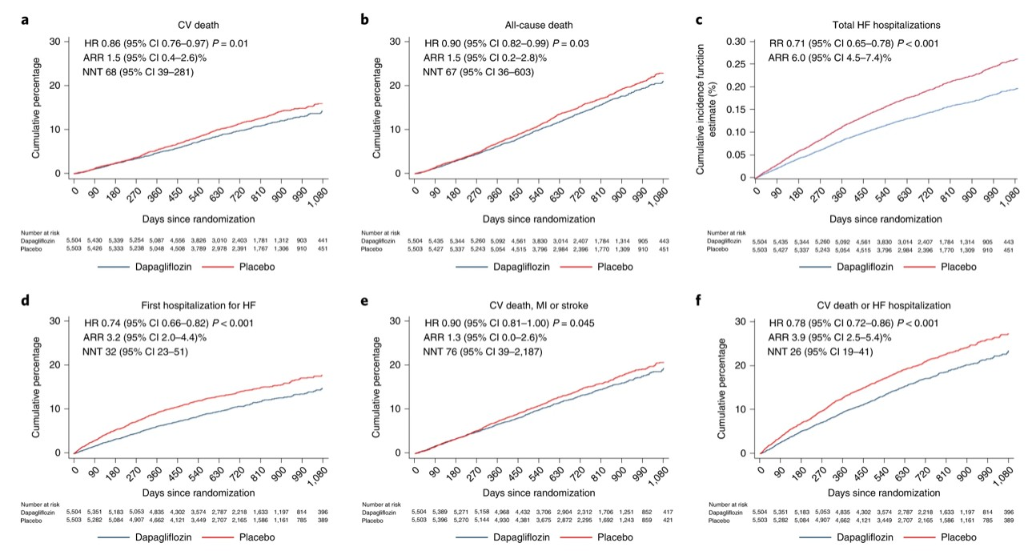
EFFECT OF DAPAGLIFLOZIN ON KEY CLINICAL OUTCOMES IN POOLED DAPA-HF AND DELIVER DATASET
a–f, Incidence of: death from CV causes (a); death from all causes (b); the total number of hospital admissions for HF (c); time to first hospital admission for HF (d); death from CV causes, MI or stroke (e); and death from CV causes or hospital admission for HF (f), according to randomized therapy. Participants randomized to dapagliflozin are shown in blue and those randomized to placebo in red. All figures are Kaplan–Meier curves with an HR and 95% CI estimated from Cox’s model with two-sided P values except for the total number of hospital admissions for HF, which was plotted using the Gosh and Lin method accounting for death from CV causes (the RR is estimated from the joint frailty model with a two-sided P value). No adjustment for multiple comparisons was made. NNT indicates the number of patients who need to be treated over the median duration of follow-up to prevent one event (of the type in each panel). An NNT could not be calculated for the total number of hospital admissions for HF because this was an episode- based rather than a patient-based analysis (that is, patients may have had more than one hospital admission). ARRs and NNTs are shown with a 95% CI.

Slide 3
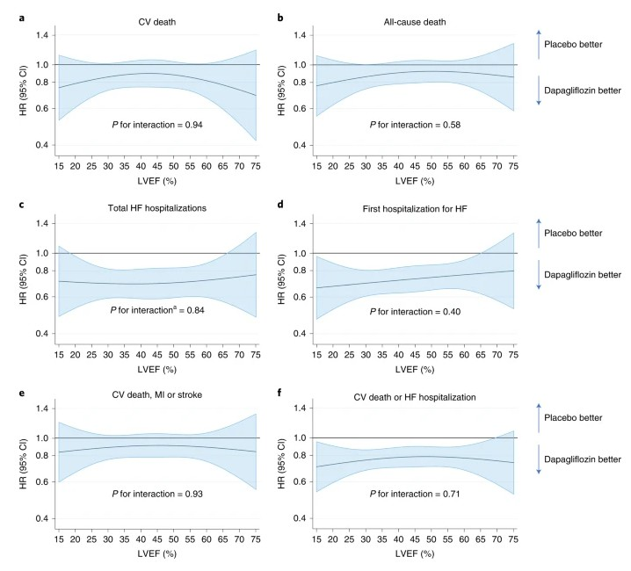
EFFECT OF DAPAGLIFLOZIN ON CLINICAL OUTCOMES ACROSS THE RANGE OF EJECTION FRACTION
a–f, Effect of dapagliflozin on: death from CV causes (a); death from all causes (b); the total number of hospital admissions for HF (c); time to first hospital admission for HF (d); death from CV causes, MI or stroke (e); and death from CV causes or hospital admission for HF (f), according to baseline LVEF. The horizontal blue line shows the continuous HR across the range of LVEF and the shaded area around this line represents the 95% CI from Cox’s model. The overall effect of treatment in the pooled population is shown in each panel as an HR (95% CI) with the two-sided P value from Cox’s model for Wald’s test of interaction between treatment and LVEF. No adjustment for multiple comparisons was made. aRestricted cubic spline and interaction P value derived from LWYY model for total HF hospitalization.

Slide 4
EFFECT OF RANDOMIZED TREATMENT ON CV DEATH ACCORDING TO THE PRE-SPECIFIED SUBGROUPS
Estimates are HRs with error bars representing 95% CIs from Cox’s model and a two-sided P value for interaction from Wald’s test of Cox’s model. No adjustment for multiple comparisons was made. aNot a pre-specified subgroup.

Slide 5
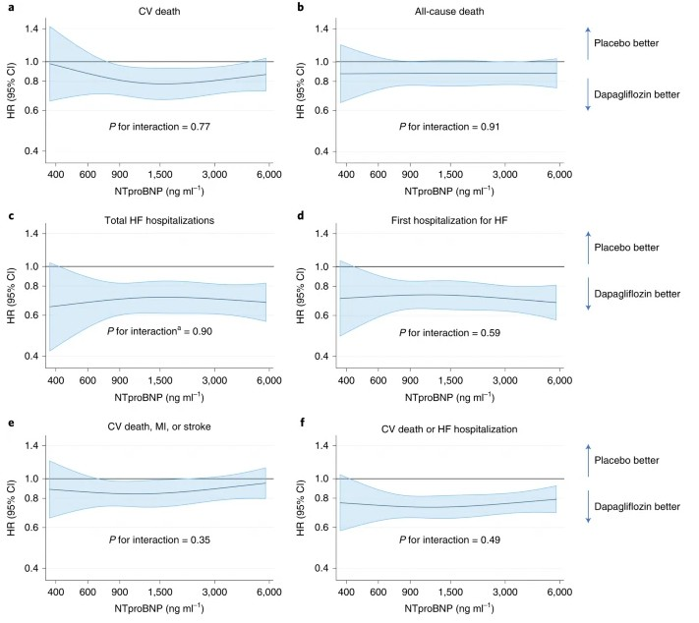
EFFECT OF DAPAGLIFLOZIN ON CLINICAL OUTCOMES ACROSS THE RANGE OF NT-PROBNP
a–f, Effect of dapagliflozin on: death from CV causes (a); death from all causes (b); the total number of hospital admissions for HF (c); time to first hospital admission for HF (d); death from CV causes, MI or stroke (e); and death from CV causes or hospital admission for HF (f), according to baseline NT-proBNP level. The horizontal blue line shows the continuous HR across the range of NT- proBNP levels at baseline and the shaded area around this line represents the 95% CI from Cox’s model. The overall effect of treatment in the pooled population is shown in each panel as an HR (95% CI) with the two-sided P value for Wald’s test of interaction between treatment and NT-proBNP level from Cox’s model. No adjustment for multiple comparisons was made. aRestricted cubic spline and interaction P value derived from LWYY model for total HF hospitalization.

Slide 6

RESULTS
DAPA-HF
DELIVER
LVEF ≤40%
Patients with HFrEF
26% RRR 4.9% ARR
LVEF >40%
Patients with HFmrEF and HFpEF,
and a subgroup with HFimpEF
- Heart failure places significant burden,
with a 5-year mortality rate of ~50%
for patients,1 87% of whom have ≥3
Comorbidities2
- Dapagliflozin reduced CV death or worsening HF by 26% vs. placebo*, consistent in patients with and without T2D3
- Dapagliflozin is the first SGLT2i to demonstrate
reduction in CV death vs. placebo in HF3
- Dapagliflozin was well-tolerated in patients with and without T2D3
- Due to an ageing population demographic, roughly half
of all known HF patients have LVEF >40%, which comes with it an increased prevalence of comorbidities1
- Dapagliflozin was generally well tolerated
in patients with and without T2D2
- Dapagliflozin reduced CV death

Slide 7

RESULTS
By 14% in Deaths caused due to CVs
In Patient’s with HF
By 10% in Deaths from any cause
By 29% in hospitalization due to HFs
By 10% in death from CV causes, Stroke or MI in a patient with HF
CONCLUSION
This analysis demonstrates that, in patients with HF, dapagliflozin led to significant reductions in the risk of death from CV causes and any cause, as well as MACE, irrespective of LVEF. There was a larger reduction in total hospital admissions for HF than in death, which was also consistent across the range of ejection fractions. Most patients with HF, regardless of ejection fraction, are likely to benefit from treatment with an SGLT2 inhibitor, although the ARR is somewhat smaller in patients with higher compared with lower ejection fractions. This analysis supports a recommendation that treatment with dapagliflozin can be initiated in patients with a clinical diagnosis of HF and no contraindications, even if a measurement of ejection fraction is awaited.

